Slide 1
MEMBER RESOURCES CENTER

Slide 2
Agenda
How to Log In
Demo
Categories
Process

Slide 3
How To Log In
From The Cerrado Group Home Page – select the Member Resources Login link at the bottom of the page.

Slide 4
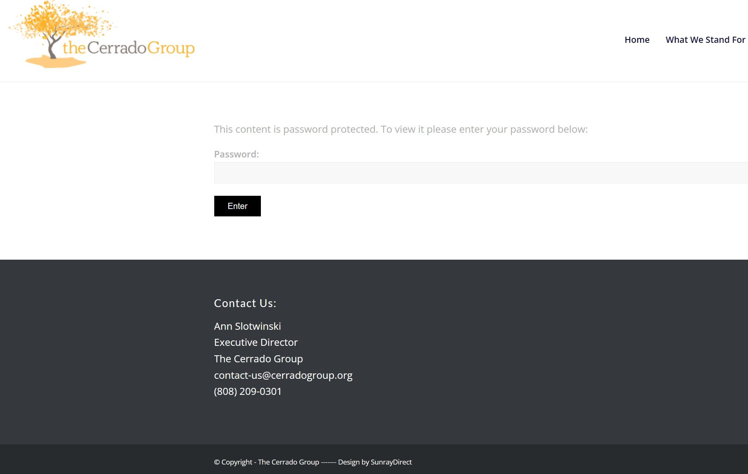
How To Log In
Enter the Password on the Login Screen that comes up…Everyone has the same password for this page CerradoG@!921

Slide 5
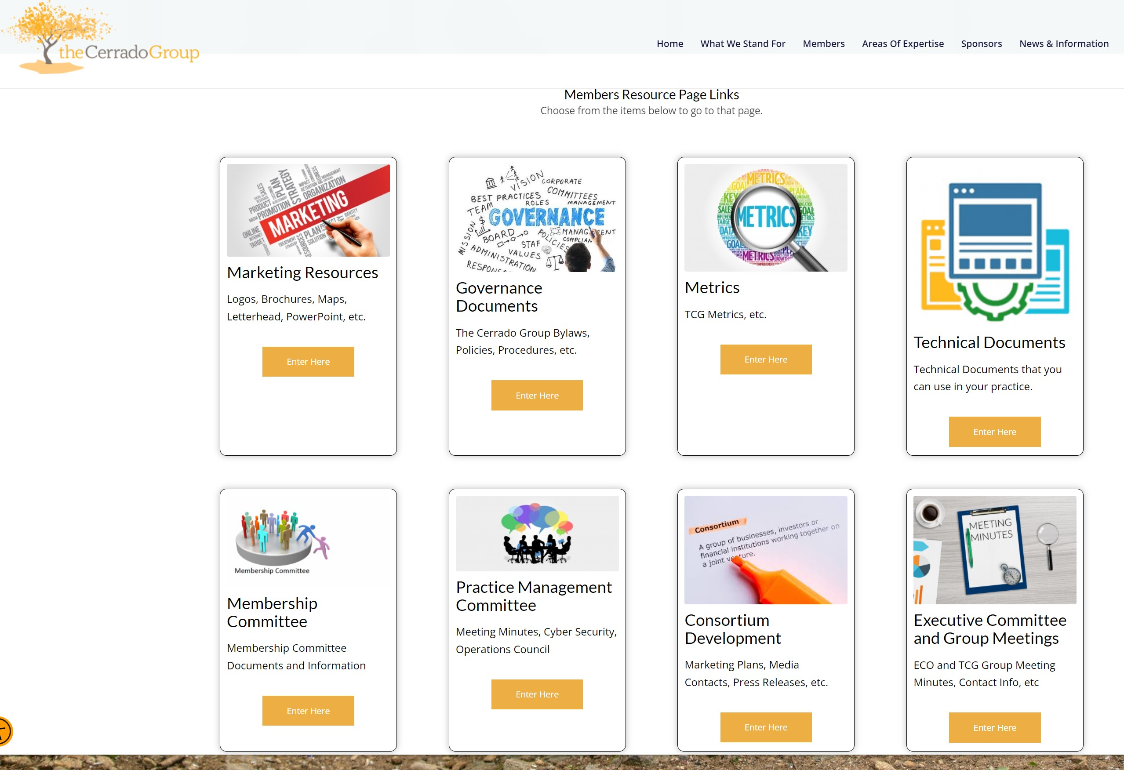
How To Log In
You can now access all the member specific content that is stored in the website.
***All members should be using the Logos and Color Guidance, etc. that are on the Marketing Resources page.

Slide 6
DEMO
https://cerradogroup.org

Slide 7
Existing Categories
TCG Marketing-logos, brochures PowerPoint Template
TCG Governance- By-Laws, Agreements, Policies and Procedures
TCG Metrics
Member Technical Documents-explanations of plan provisions and design, legislation etc.
Committee Minutes
TCG and ECO Minutes- are these valuable?
New Categories
TCG PowerPoint Presentations
Annual Meeting Minutes and Documents
Cyber Security Documents
Member PowerPoint Presentations
Member Marketing Pieces
Training Materials
What Else?

Slide 8
Process
Send File Directly to Peter Conti at peter@sunraydirect.com
You will need to tell him what category to post it under
Good idea to include the date you send the file to Peter in the name of the file- must use month-day-year format eg. 8-20-2023

